Slide 1


Department of BES-I
COURSE: Data Structures
COURSE CODE: 24SC1204
Topic:
Name of the topic:
Circular Linked List
Session – 12

Slide 2



AIM OF THE SESSION
To familiarize students with the basic concept of Circular linked list
INSTRUCTIONAL OBJECTIVES
This Session is designed to:
Demonstrate The Circular linked list
Describe the types of circular linked list.
List out the operations possible on the circular linked list.
Describe the each operation
List out the advantages and applications of CLL.
LEARNING OUTCOMES
At the end of this session, you should be able to:
Define Circular linked list
Describe two types of circular linked list. And their operations
Summarize definition, types and operations of circular linked list and its applications

Slide 3
.
Circular Linked list
INTRODUCTION
A circular linked list is a series of nodes .
Each element is connected to its successor element
the last element loops back to the first element
creates a continuous circle of connections.
1
1001100
2
10096
10096
1001100

Slide 4
Circular Linked list
Advantages of a Circular linked list
Entire list can be traversed from any node.
Circular lists are the required data structure when we want a list to be accessed in a circle or loop.
Despite of being singly circular linked list we can easily traverse to its previous node, which is not possible in singly linked list.
Disadvantages of Circular linked list
Circular list are complex as compared to singly linked lists.
Reversing of circular list is a complex as compared to singly or doubly lists.
If not traversed carefully, then we could end up in an infinite loop.

Slide 5
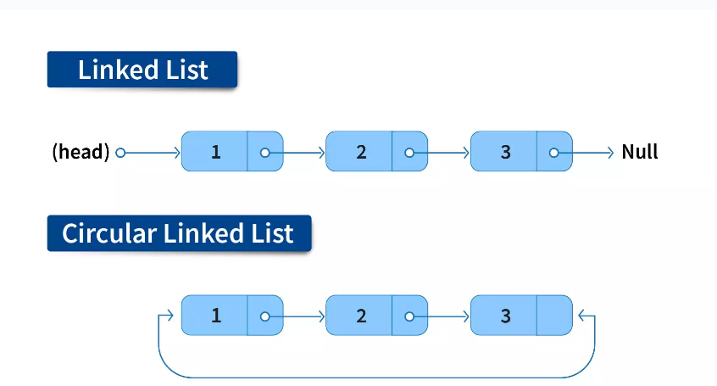
Example of Circular Linked list with 3 nodes
  Circular Singly Linked list
  Circular Doubly Linked list
Types -

Slide 6
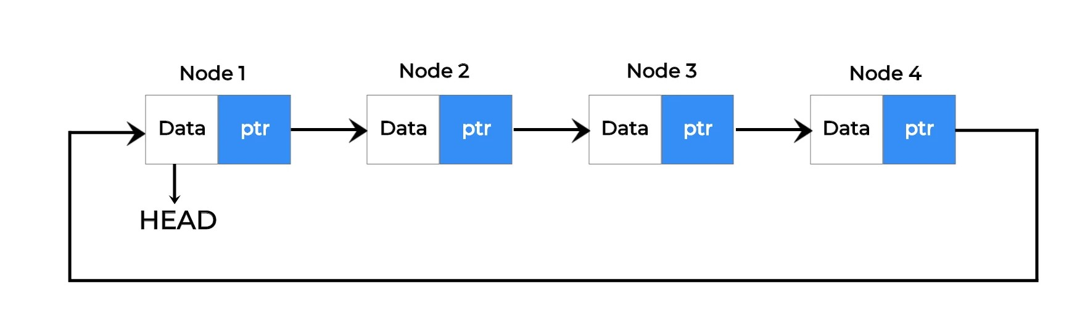
Types of CLL Cont…
1. Circular Singly Linked List
Here, the address of the last node consists of the address of the first node.

Slide 7
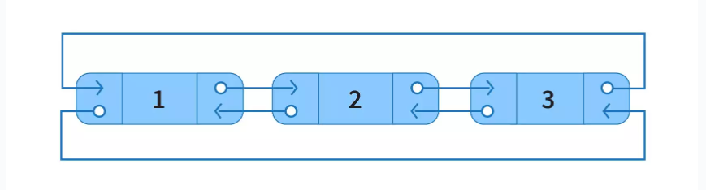
Types of CLL Cont…
2. Circular Doubly Linked List
Here, in addition to the last node storing the address of the first node, the first node will also store the address of the last node.

Slide 8
Setup the Circular Linked List
Before we implement those operations, first we need to setup empty list.
Perform the following steps to setup Empty CLL:.
Step 1 - Define a Node structure with two members/fields data and next
Step 2 - Define a Node pointer 'head' and set it to NULL.
Step 3 – Then perform the Operations one by one.

Slide 9
OPERATIONS ON CIRCULAR LINKED LIST (Cont..)
Creation of list
Insertion of node
    At the beginning of list
    At any position in the list
    At the end of list
Deletion of node
    Deletion of first node
    Deletion of node from middle of the list
    Deletion of last node

Slide 10
Algorithm for Creating & displaying a circular linked list
Define a Node class which represents a node in the list. It has two properties data and next which will point to the next node.
Define another class for creating the circular linked list and it has two nodes: head and tail. It has two methods: add() and display() .
add() will add the node to the list:
  It first checks whether the head is null, then it will insert the node as the head.
  Both head and tail will point to the newly added node.
  If the head is not null, the new node will be the new tail, and the new tail will point to the head as it is a circular linked list.
display() will show all the nodes present in the list.
  Define a new node 'current' that will point to the head.
  Print current.data till current will points to head
  Current will point to the next node in the list in each iteration.

Slide 11
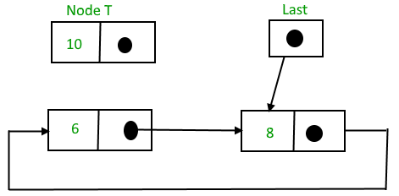
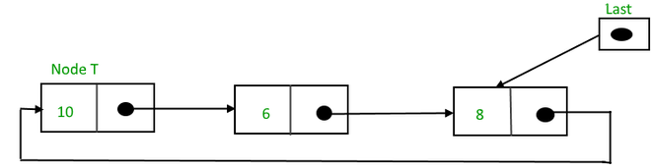
i) Insertion At Beginning of the CLL

Slide 12
i) Insertion At Beginning of the CLL
Step 1: IF PTR = NULL {Write OVERFLOW (Go to Step 11) [END OF IF]
Step 2: SET NEW_NODE = PTR
Step 3: SET PTR = PTR -> NEXT
Step 4: SET NEW_NODE -> DATA = VAL
Step 5: SET TEMP = HEAD
Step 6: Repeat Step 8 while TEMP -> NEXT != HEAD
Step 7: SET TEMP = TEMP -> NEXT[END OF LOOP]
Step 8: SET NEW_NODE -> NEXT = HEAD
Step 9: SET TEMP → NEXT = NEW_NODE
Step 10: SET HEAD = NEW_NODE
Step 11: EXIT

Slide 13
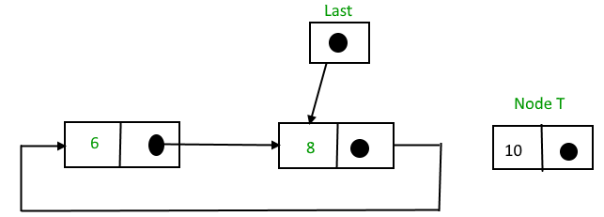
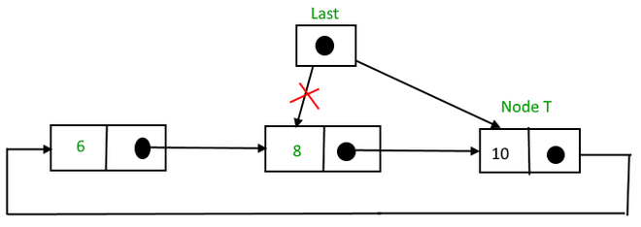
ii) Insertion At End of the CLL (Deletion of Last node)

Slide 14
ii) Insertion At End of the CLL (Last node)
Step 1: IF PTR = NULL Write OVERFLOW(Go to Step 1)[END OF IF]
Step 2: SET NEW_NODE = PTR
Step 3: SET PTR = PTR -> NEXT
Step 4: SET NEW_NODE -> DATA = VAL
Step 5: SET NEW_NODE -> NEXT = HEAD
Step 6: SET TEMP = HEAD
Step 7: Repeat Step 8 while TEMP -> NEXT != HEAD
Step 8: SET TEMP = TEMP -> NEXT [END OF LOOP]
Step 9: SET TEMP -> NEXT = NEW_NODE
Step 10: EXIT

Slide 15
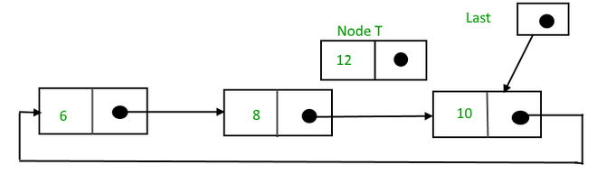
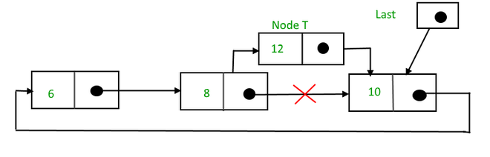
iii) Inserting a New node at middle of the CLL

Slide 16
iii) Inserting a New node at middle of the CLL
To insert a node in between the two nodes, follow these steps:
Create a node, say T.
Search for the node after which T needs to be inserted, say that node is P.
Make T -> next = P -> next;
P -> next = T.

Slide 17
i)Deletion in circular singly linked list at beginning
There are three scenarios-
Scenario 1: (The list is Empty)
If the list is empty then the condition head == NULL will become true, in this case, we just need to print underflow on the screen and make exit.
Scenario 2: (The list contains single node)
If the list contains single node then, the condition head → next == head will become true. In this case, we need to delete the entire list and make the head pointer free.
Scenario 3: (The list contains more than one node)
If the list contains more than one node then, in that case, we need to traverse the list

Slide 18
i)Deletion in circular singly linked list at beginning
Step 1: IF HEAD = NULL
Write UNDERFLOW (Go to Step 8) [END OF IF]
Step 2: SET PTR = HEAD
Step 3: Repeat Step 4 while PTR → NEXT != HEAD
Step 4: SET PTR = PTR → next [END OF LOOP]
Step 5: SET PTR → NEXT = HEAD → NEXT
Step 6: FREE HEAD
Step 7: SET HEAD = PTR → NEXT
Step 8: EXIT

Slide 19
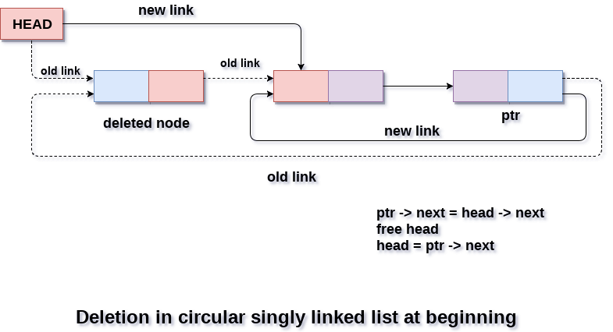
i)Deletion in circular singly linked list at beginning

Slide 20
ii)Deletion in circular singly linked list from Middle
  Case 1: List is empty
  Then simply just return from the function.
  Case 2: List has only one node
  It means head == tail then assigned head and tail equal to null.
  Case 3: List has only two nodes
  It means the middle node of the list at 1 position. In this case, we have to modify the head and tail also. Head becomes tail and tail.next becomes also tail.
  Case 4: List has more than two nodes
  It means the position of the middle node is greater than 1. In this case, we define the two-node temp and prev. Assign head to the temp.
  Then traverse the list using temp up to the middle node. In each iteration assign prev = temp and temp = temp.next
  Now temp is pointing to middle node and prev pointing to previous node of the middle node.
  Then simply set prev.next=temp.next and temp=null,

Slide 21
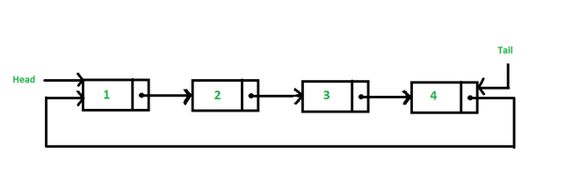
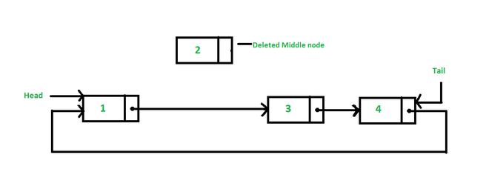
ii)Deletion in circular singly linked list from Middle

Slide 22
ii)Deletion in Circular singly linked list at the end
There are three scenarios
Scenario 1: (The list is Empty)
If the list is empty then the condition head == NULL will become true, in this case, we just need to print underflow on the screen and make exit.
Scenario 2: (The list contains single node)
If the list contains single node then, the condition head → next == head will become true. In this case, we need to delete the entire list and make the head pointer free.
Scenario 3: (The list contains more than one node)
If the list contains more than one element, then in order to delete the last element, we need to reach the last node.

Slide 23
ii)Deletion in circular singly linked list at end
Step 1: IF HEAD = NULL
Write UNDERFLOW (Go to Step 8) [END OF IF]
Step 2: SET PTR = HEAD
Step 3: Repeat Steps 4 and 5 while PTR -> NEXT != HEAD
Step 4: SET PREPTR = PTR
Step 5: SET PTR = PTR -> NEXT [END OF LOOP]
Step 6: SET PREPTR -> NEXT = HEAD
Step 7: FREE PTR
Step 8: EXIT

Slide 24
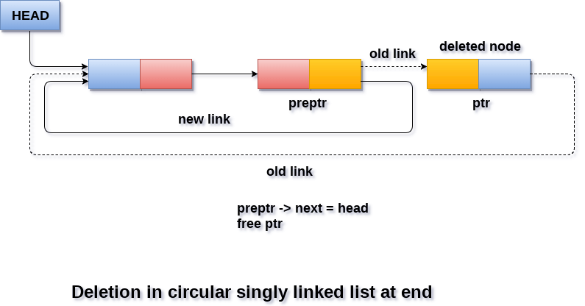
ii)Deletion in circular singly linked list at end

Slide 25
SUMMARY
A circular linked list is a sequence of elements in which every element has a link to its next element in the sequence and the last element has a link to the first element.
That means circular linked list is similar to the single linked list except that the last node points to the first node in the list
In a circular linked list, we perform the following operations...
i) Insertion ii) Deletion iii) Display iv) Search
The insertion operation can be performed in three ways. They are as follows...
i) Inserting At Beginning of the list
ii) Inserting At End of the list
iii) Inserting At Specific location in the list
The deletion operation can be performed in three ways those are as follows...
i) Deleting from Beginning of the list
ii) Deleting from End of the list
iii) Deleting a Specific Node

Slide 26
SUMMARY (Cont..)
Circular linked lists are a type of linked list where the last node points back to the first node, forming a loop. This circular structure allows continuous traversal from any node in the list. Key aspects include:
Structure: Nodes are linked in a sequence, and the last node connects back to the first node, creating a circular loop.
Traversal: Special attention is needed during traversal to prevent infinite loops within the circular structure. Proper exit conditions or marking visited nodes are essential.
Operations: Insertion, deletion, and traversal operations require careful handling of pointers to maintain the circular structure.
Memory Management: They offer benefits in memory allocation due to their continuous loop structure.
Applications: Used in scenarios requiring continuous looping behavior, like round-robin scheduling or circular buffers in memory management.
Cycle Detection: Techniques like Floyd's cycle detection algorithm are employed to detect cycles within the list.

Slide 27
SUMMARY
In a circular linked list, we perform the following operations...
i) Insertion ii) Deletion iii) Display iv) Search
The insertion operation can be performed in three ways. They are as follows...
i) Inserting At Beginning of the list
ii) Inserting At End of the list
iii) Inserting At Specific location in the list
The deletion operation can be performed in three ways those are as follows...
i) Deleting from Beginning of the list
ii) Deleting from End of the list
iii) Deleting a Specific Node

Slide 28
SELF-ASSESSMENT QUESTIONS
In a circular linked list with n nodes, how many pointers need to be updated when deleting the last node?
One
Two
None
n
2. Which of the following is false about a circular linked list?
a) Every node has a successor
b) Time complexity of inserting a new node at the head of the list is O(1)
c) Time complexity for deleting the last node is O(n)
d) We can traverse the whole circular linked list by starting from any point

Slide 29
TERMINAL QUESTIONS
Explore the scenarios where circular linked lists are preferred over other data structures, such as arrays or doubly linked lists. Highlight the specific applications or problems where the circular nature of the list provides a significant advantage.
2. List out different types of Circular linked lists?
3. List out different operations can perform on Circular linked lists?
4. Analyze the time complexity of the CLL for the operations such as insertion, deletion, and search
5.Describe the potential drawbacks or challenges of implementing circular linked lists compared to singly linked lists. Highlight scenarios where circularity might lead to complexities or inefficiencies in data manipulation

Slide 30
REFERENCES FOR FURTHER LEARNING OF THE SESSION
Reference Books:
1. Data Structures and Algorithm Analysis in PYTHON, 2010, Mark Allen Weiss, Second Edition, Pearson Education.
2. Data Structures and Algorithms, A.V.Aho, J.E.Hopcroft, and J.D.Ullman, Pearson Education, First Edition Reprint2003.
3. Advanced Guide to Python 3 Programming, John Hunt, 4th Edition, Springer Nature Switzerland AG 2019.
4. Python Basics: A Practice Introduction to Python 3, David Amos, Dan Bader, Joanna Jablonski, Fletcher Heisler, 4th edition, Real Python.
Web Links:
1. https://docs.python.org/3/tutorial/datastructures.html
2. https://www.w3schools.com/dsa/dsa_intro.php
3. https://www.geeksforgeeks.org/python-data-structures/

Slide 31
THANK YOU
Team – Data Structures

